Slide 1

Obstacle Course Game
Daniel Foth

Slide 2
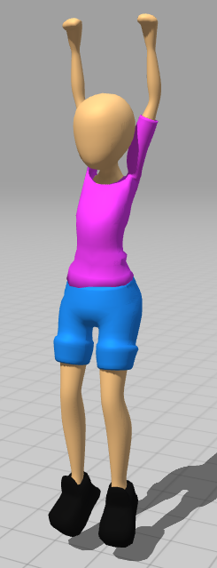
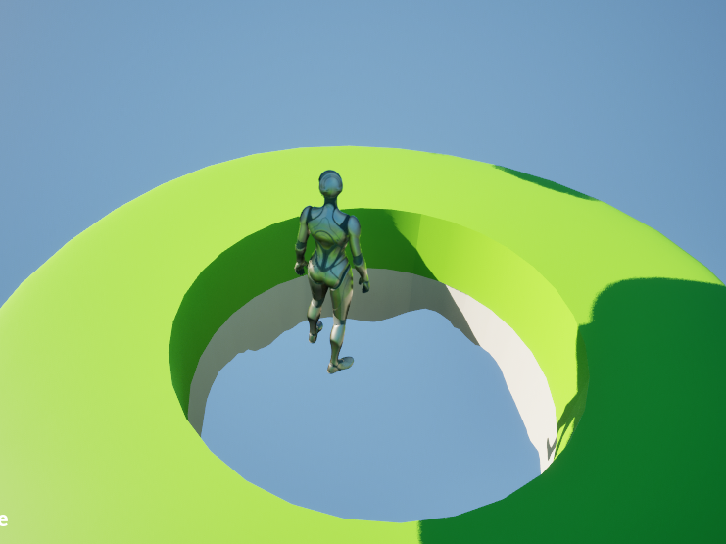

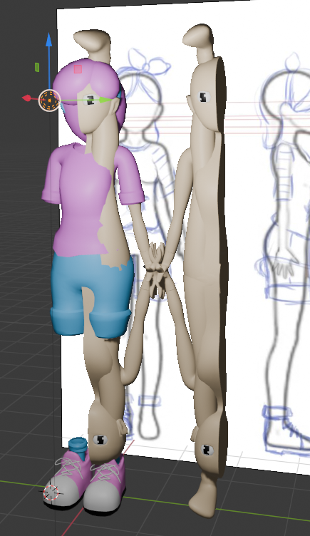
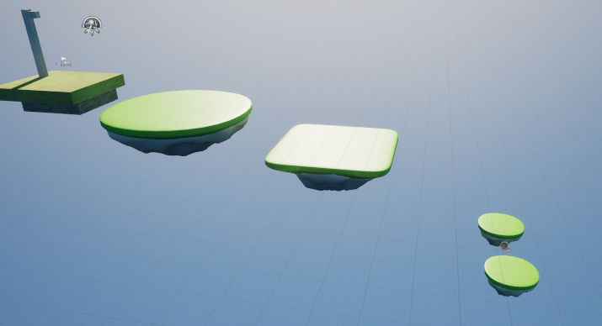
Features
Done
Gliding
Fall Damage
Collectables
Disappearing Platforms
Game Over Menu
In Progress
Audio
Outstanding
Menus
Lighting
Balancing
Finishing Touches
Obstacles – Possible won't do?
Won't Do
Collectable Power Ups

Slide 3
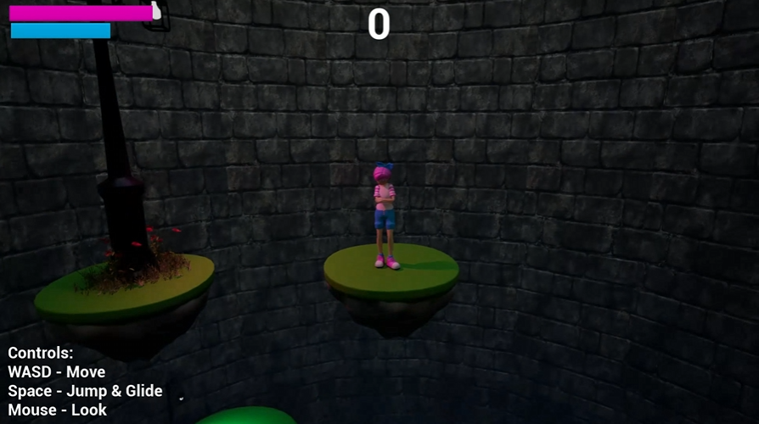
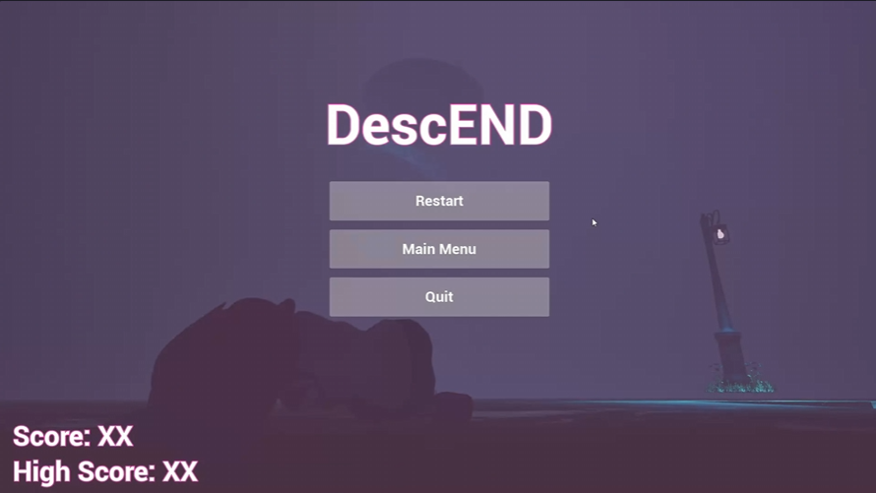
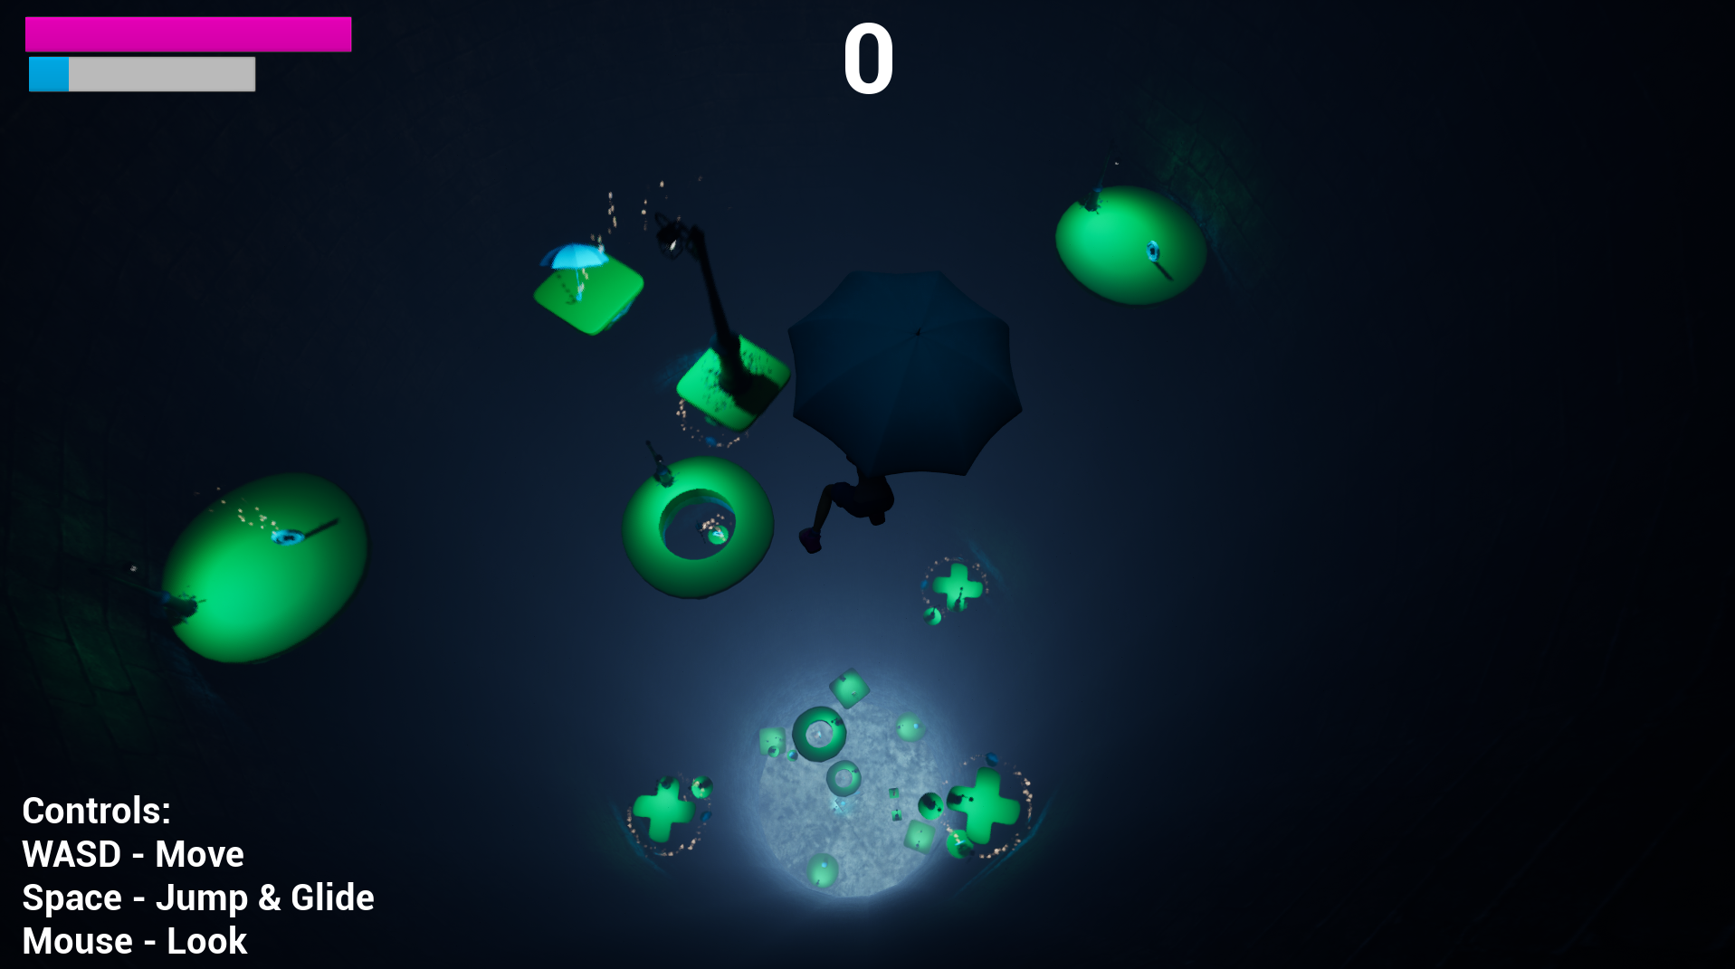
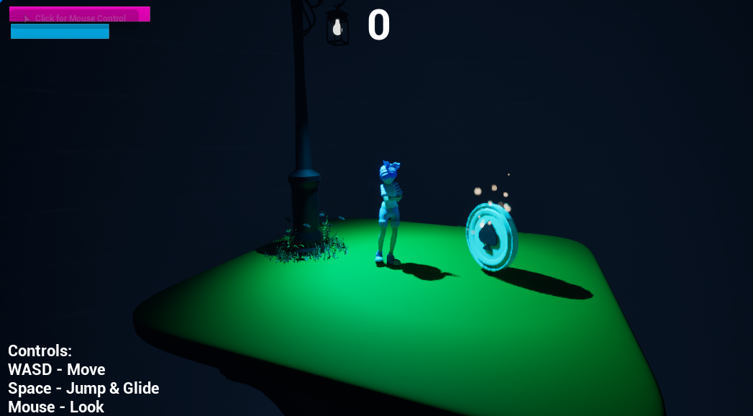
Design

Slide 4
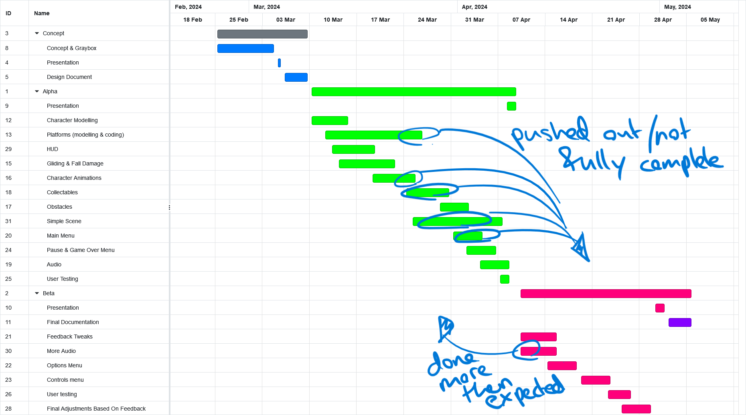
Roadmap

Slide 5
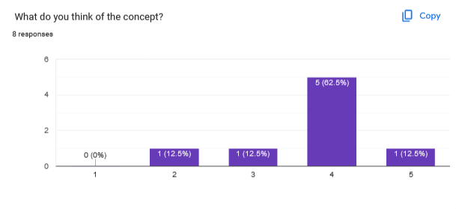
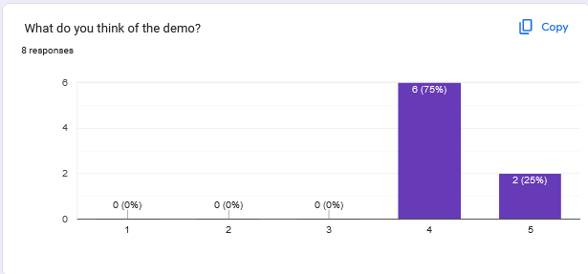
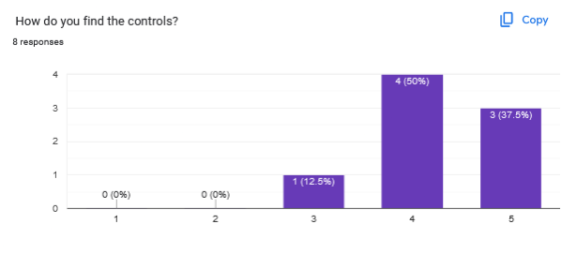
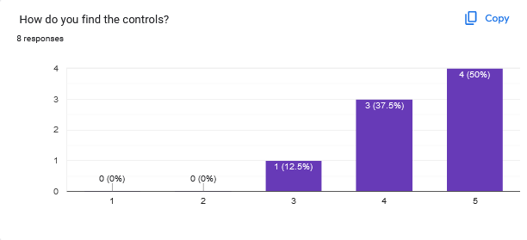
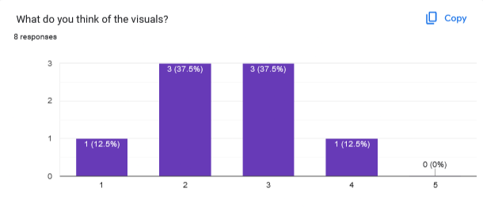
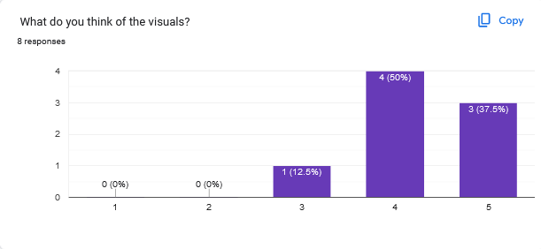
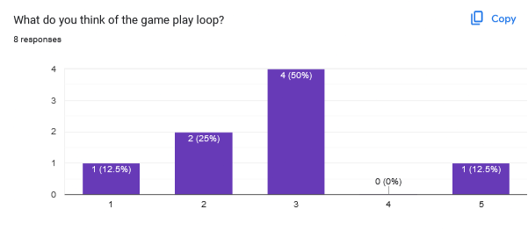
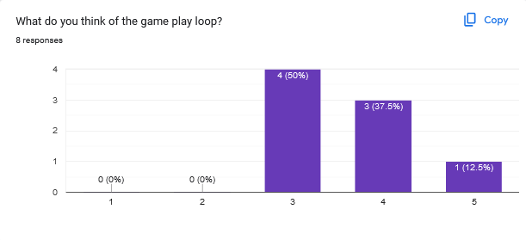
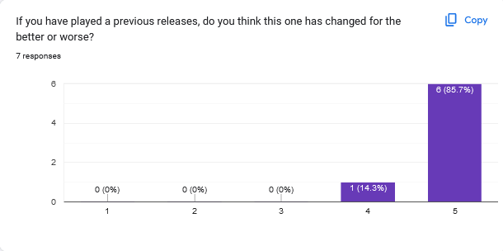
User Testing
Positive trend in all areas, with a lot more feedback
The goal still seems unclear for some – especially at the bottom
Things users enjoyed:
Music/Audio
Game Over screen pun
Intuitive controls
Some Like the dark lighting and theme <- I'm not fully convinced
Some standout recommendations to work on for beta:
Balancing – slow down platforms disappearing, lower platform rotation.
Main Menu – Users didn’t like being thrown straight in, especially since they couldn’t figure out the controls first
When gliding starts the controls are clunky if the player has no forward momentum
Platforms pass through the tunnel walls, out of the level – intentional but looks like a bug to users
Bottom of the hole is bland
Final Score/High Score needed
Lack Feedback for fall damage – audio is not enough for some
CAMERA!!! - tried but failed

Slide 6
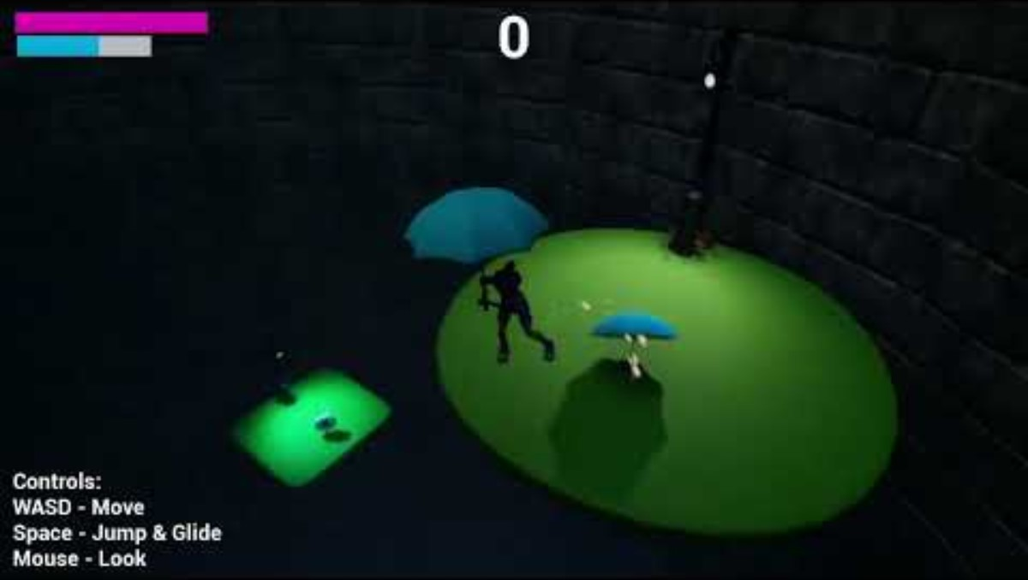
Demo

Slide 7

Questions?

